Slide 1
GUM
AI

Slide 2
Update Log
GumoOS 3.0.0 Update Log
Fixed the issue of time offset.
Fixed the font offset issue in the AI settings interface.
Fixed the misalignment issue of the AI icon.
Fixed some words in AI setting the first step.
Deleted some slides.
Fixed Gumo Intelligence(in Setting App) fonts used the wrong one problem.
I Agree
I Disagree

Slide 3


October 11 Saturday
09:41
User
Login

Slide 4







E
Edge
F
0ms
09:41
2025/10/11

Slide 6
×
Setting
User
U
Wi-Fi
Satellite Fuction
About this computer
Software Update
Gumo Intelligence

Slide 7
×
Setting
User
U
Connect
Since the Satellite Function is in the testing phase, there may inevitably be some issues. Please use the Satellite Function with caution.
Wi-Fi
Satellite Fuction
About this computer
Software Update
Gumo Intelligence

Slide 8
Satellite Fuction Before Using Notice
The Satellite Function needs to be used in an open and unobstructed area. Avoid signal blockage by obstacles, and stay away from objects that may interfere with the signal, such as high-voltage lines and large metal equipment.
The Satellite Function may consume a large amount of power. Please ensure that the battery is fully charged before use.
When using the Satellite Function, please abide by local laws and regulations. It is prohibited to use it for illegal activities.
As the Satellite Function is in the testing phase, there may inevitably be some issues. Please use the Satellite Function with caution and avoid exposing personal information during use; otherwise, illegal elements may steal your personal information through vulnerabilities.
I can’t wait to use it!
I want to go back.

Slide 9
Auto-aligning in progress
Disconnect

Slide 10
Auto-aligning in progress
Disconnect

Slide 11
Auto-aligning in progress
Disconnect

Slide 12
Auto-aligning in progress
Disconnect

Slide 13
Auto-aligning in progress
Disconnect

Slide 14
Connecting…(60 Seconds)
Disconnect

Slide 15
Connecting… (59 Seconds)
Disconnect

Slide 16
Connecting… (58 Seconds)
Disconnect

Slide 17
Connecting… (57 Seconds)
Disconnect

Slide 18
Connection successful

Slide 19
Connection successful
Go back to Desktop
Go back to Setting

Slide 20
×
Setting
User
U
The GumoOS is developed by GUMO_.
Wi-Fi
Version: Official Version 3.0.0
Processor: Power Point
RAM: 128 GB
Storage: 1 TB
System: GumoOS
Battery Capacity: 10000 mAh
Satellite Fuction
About this computer
Software Update
Gumo Intelligence

Slide 21
×
Setting
User
U
WLAN
Not connected
Flight mode
Wi-Fi
We not support this function
Satellite Fuction
About this computer
Software Update
Gumo Intelligence

Slide 22
×
Setting
Checking Software Update
User
GUM
U
Wi-Fi
Satellite Fuction
About this computer
Software Update
Gumo Intelligence

Slide 23
×
Setting
User
GUM
U
OS
Wi-Fi
Satellite Fuction
Your operating configuration is below the update requirements.
About this computer
Software Update
Gumo Intelligence
You can’t update

Slide 24
×
Setting
User
U
AI
Gumo Intelligence
GumoOS 2.0.0 has released the Gumo Intelligence feature, which helps users operate more conveniently in daily life and answers their questions.
Currently, Gumo Intelligence is not supported to run on the kernel of this system.
You can enable the dictation function of Gumo Intelligence in advance. Please click the button below to record your voice.
Wi-Fi
Satellite Fuction
About this computer
Software Update
Gumo Intelligence
Record

Slide 25
×
Gumo Intelligence Setting
AI , can improve our life
If you are ready, please click the button below to start.
Record My Voice
Clicking the button indicates that you agree to the User Privacy Agreement and the AICG (Artificial Intelligence Generated Content) Usage Agreement.

Slide 26

Gumo Intelligence Setting
Please say
Hey Gumo , what is the weather?
Finished

Slide 27
Gumo Intelligence Setting
Please say
Hey Gumo , send a message to my mother.
Finished

Slide 28
Gumo Intelligence Setting
Please say
Hey Gumo , call my aunt.
Finished

Slide 29
Gumo Intelligence Setting
Please say
Hey Gumo , please download new version.
Finished

Slide 30
Gumo Intelligence Setting
Please say
Hey Gumo , open the uber eats
Finished

Slide 31
Gumo Intelligence Setting
Gumo is ready
Please stay tuned for future updates.
Go back to Setting

Slide 32
×
GUMO Music
Can’t look
GumoOS Music Pre 1.0.1

Slide 33

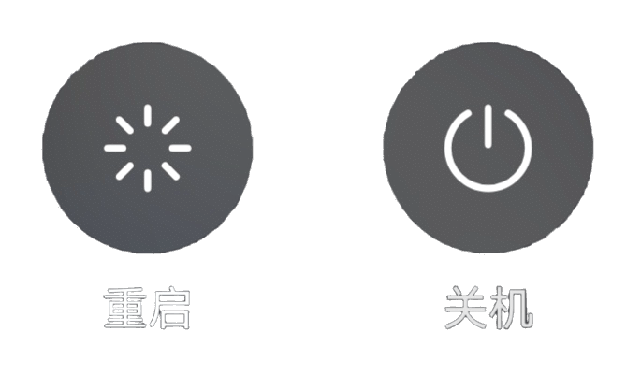
Go back to Desktop

